Slide 1



KIET Group of Institutions, Ghaziabad
(An ISO – 9001: 2008 Certified & ‘A+’ Grade accredited Institution by NAAC)
Project Presentation (KCS 753)
CRYPTOTRACKER WEBAPP
Guide Name: Mr. Vivek Kumar Sharma
Project Members
1.Akanksha Mishra 2000290120017 A
2.Anushraya Sharma 2000290120037 A
3.Anshul Sharma 2000290120031 A

Slide 2

CONTENTS
PROBLEM STATEMENT
OBJECTIVES
TECHNOLOGY USED
LITERATURE SURVEY
WORKFLOW DIAGRAM
PATENT STATUS
RESEARCH PAPER STATUS
PROJECT STATUS
REFERENCES

Slide 3
PROBLEM STATEMENT
Cryptocurrencies form an economic aspect and part of our economy and as it is a fairly new emerging domain, the information resources are widely scattered. This proves to be a major hurdle for potential and new investors as well who want to learn about this domain.
Combining information from multiple resources- evaluating which ones to trust at the same time, and doing all this at regular intervals of time (considering the volatility of cryptos) increases the slope of the learning curve involved even more.

Slide 4

OBJECTIVES
The objective is to create a web app that aims to solve this problem it is designed to present all information in a structured and centralized manner.
Perform analysis of past performance and make reliable predictions about future dips and rises.
Provide handy tools like real-time value, local currency conversions, monitoring of top-performing currencies, and other performance statistics.

Slide 5

TECHNOLOGY USED
REACT JS
MATERIAL UI
CHART JS
CSS
JAVASCRIPT
CONTEXT API
COIN GECKO API
META MASK
FIREBASE
DOCKER

Slide 6
LITERATURE SURVEY
TITLE: An Analysis of Cryptocurrency, Bitcoin, and the Future
AUTHOR: Peter D. DeVries
JOURNAL: International Journal of Business Management and Commerce
YEAR PUBLISHED: September 2016
TITLE: Assessing the probability of bankruptcy when investing in cryptocurrency
AUTHOR: Serhii Kozlovskyi , Iaroslav Petrunenko , Hennadii Mazur,Vira Butenko
JOURNAL: Investment Management and Financial Innovations
YEAR PUBLISHED: September 2022
TITLE: Understanding Cryptocurrency and its dynamics
AUTHOR: M. Ajith Kumar
JOURNAL: PLoS ONE
YEAR PUBLISHED: August 2018

Slide 7
TITLE: Cryptocurrencies: market analysis and perspectives
AUTHOR: Giancarlo Giudici· Alistair Milne · DmitriVinogradov
JOURNAL: Journal of Industrial and Business Economics
YEAR PUBLISHED: 17 September 2019
TITLE: Research Perspectives and Challenges for Bitcoin and Cryptocurrencies
AUTHOR: Joseph Bonneau, Andrew Miller, Jeremy Clark, Arvind Narayanan
JOURNAL: IEEE Symposium on Security and Privacy
YEAR PUBLISHED: 20 July 2015

Slide 8
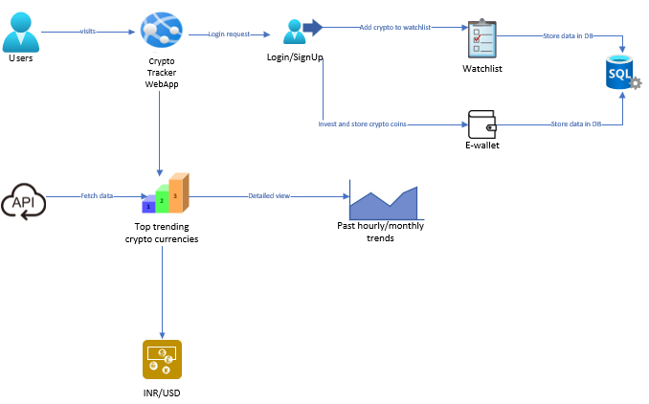
WORKFLOW DIAGRAM

Slide 9
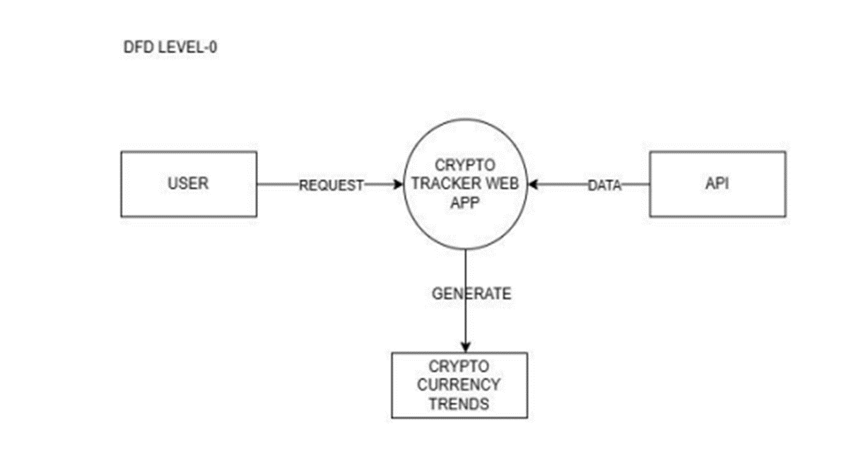
ER & DFD DIAGRAMS

Slide 10
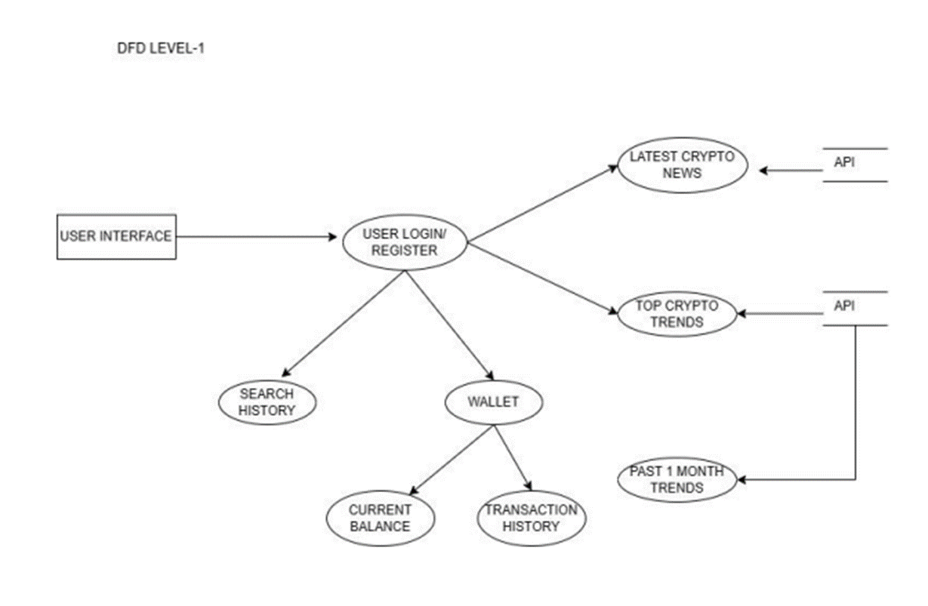

Slide 11
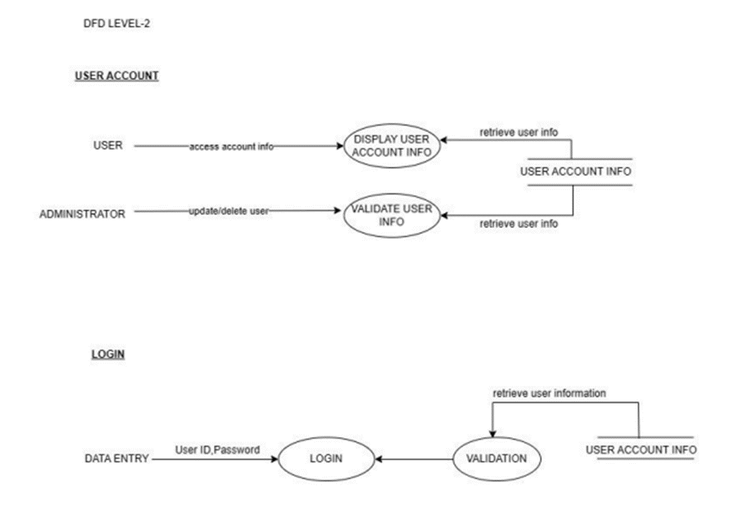

Slide 12
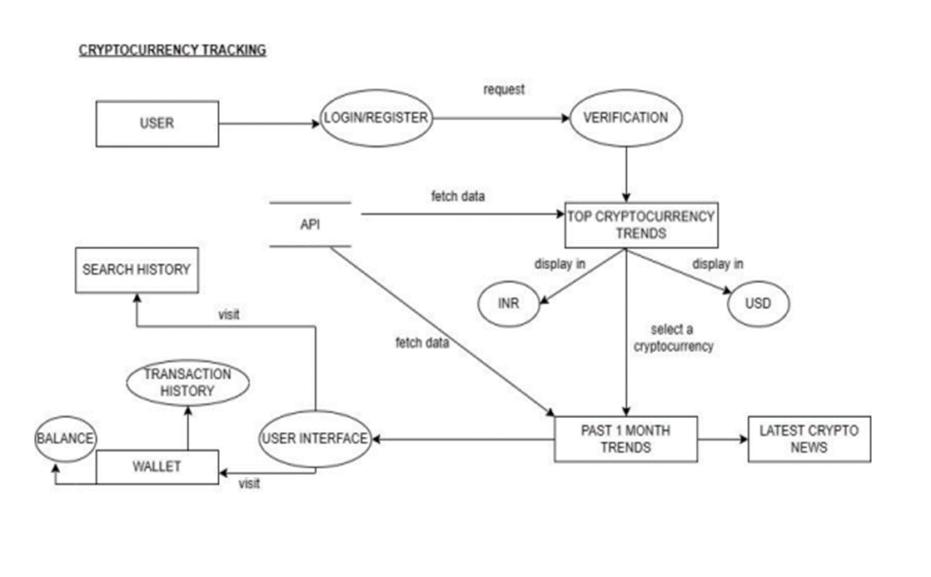

Slide 13
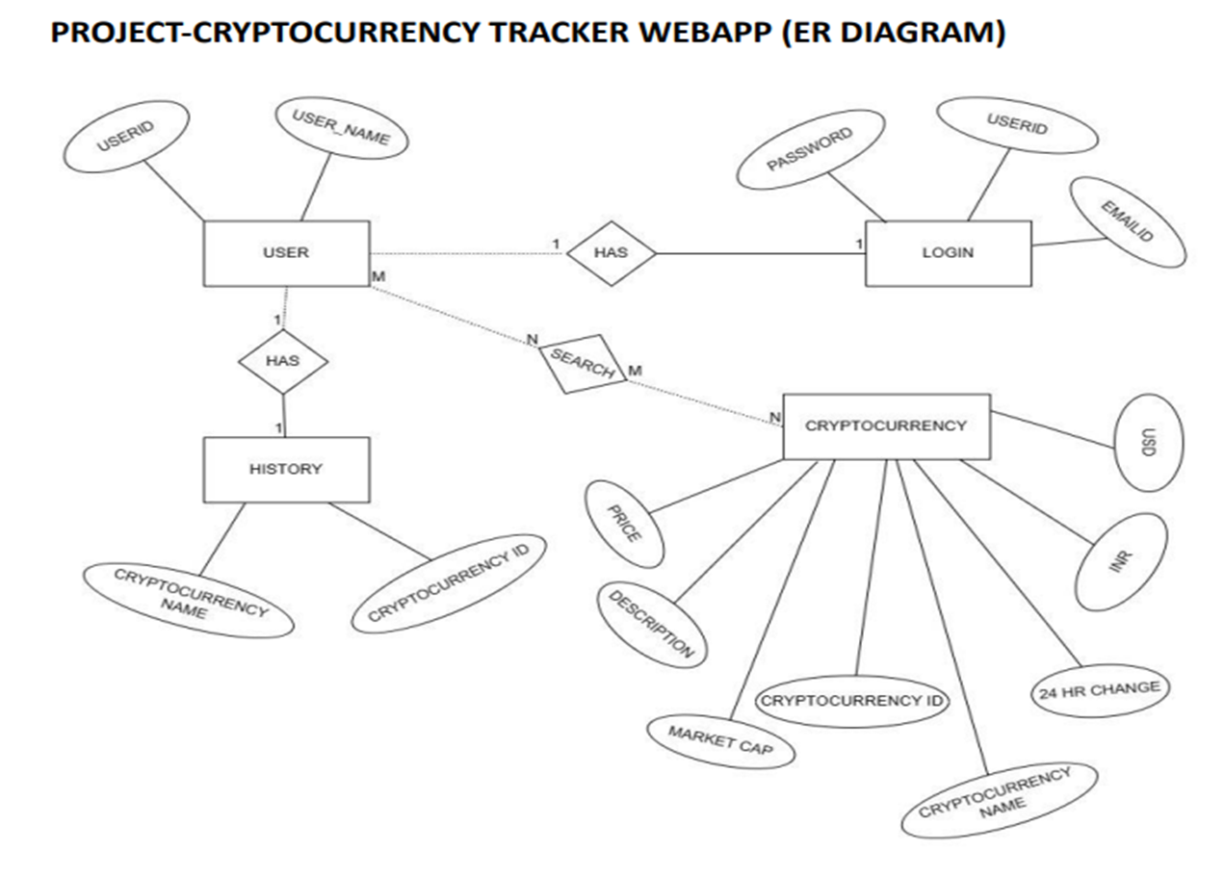

Slide 14
RESEARCH PAPER STATUS
STATUS: Communicated
Completed: 100%
Submission Proof Link- https://drive.google.com/file/d/15SFdMMN3-ZMLo419Az9Rn6U6Oro6VLYq/view?usp=sharing

Slide 15
PROJECT STATUS
STATUS: 100% COMPLETED

Slide 16
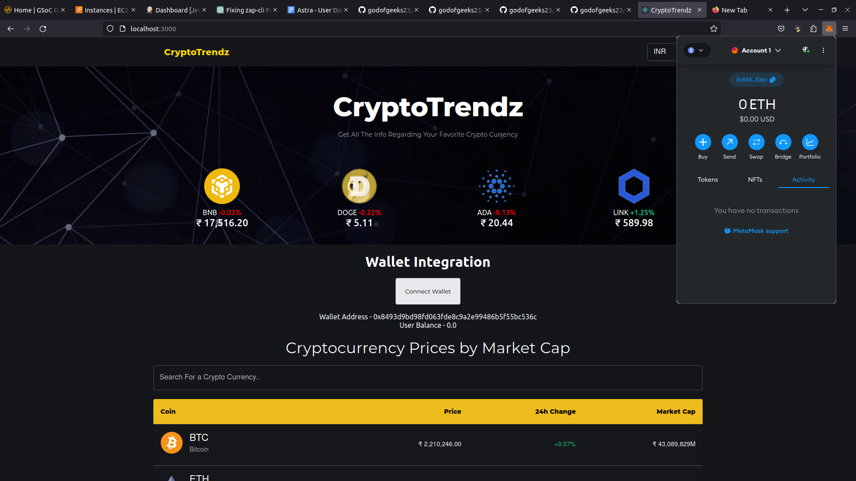

Slide 17
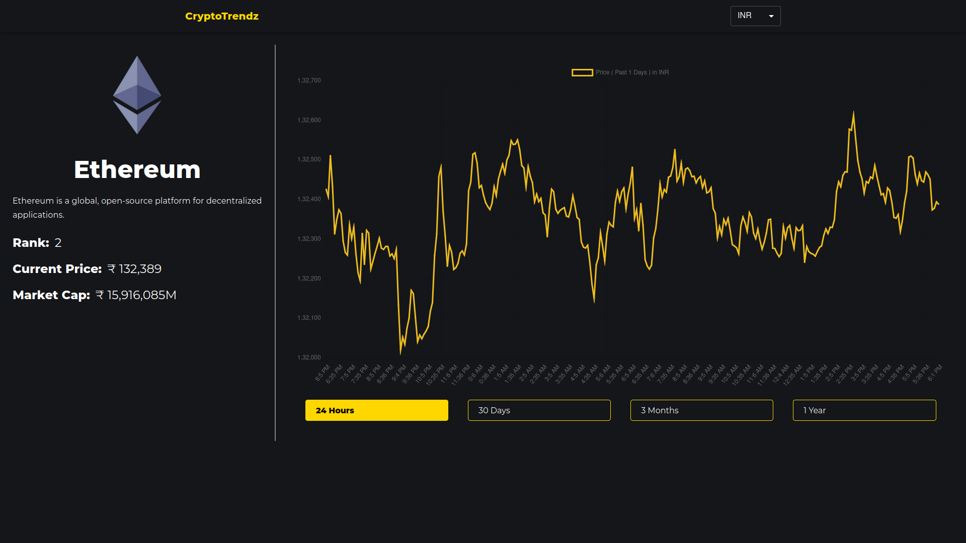

Slide 18
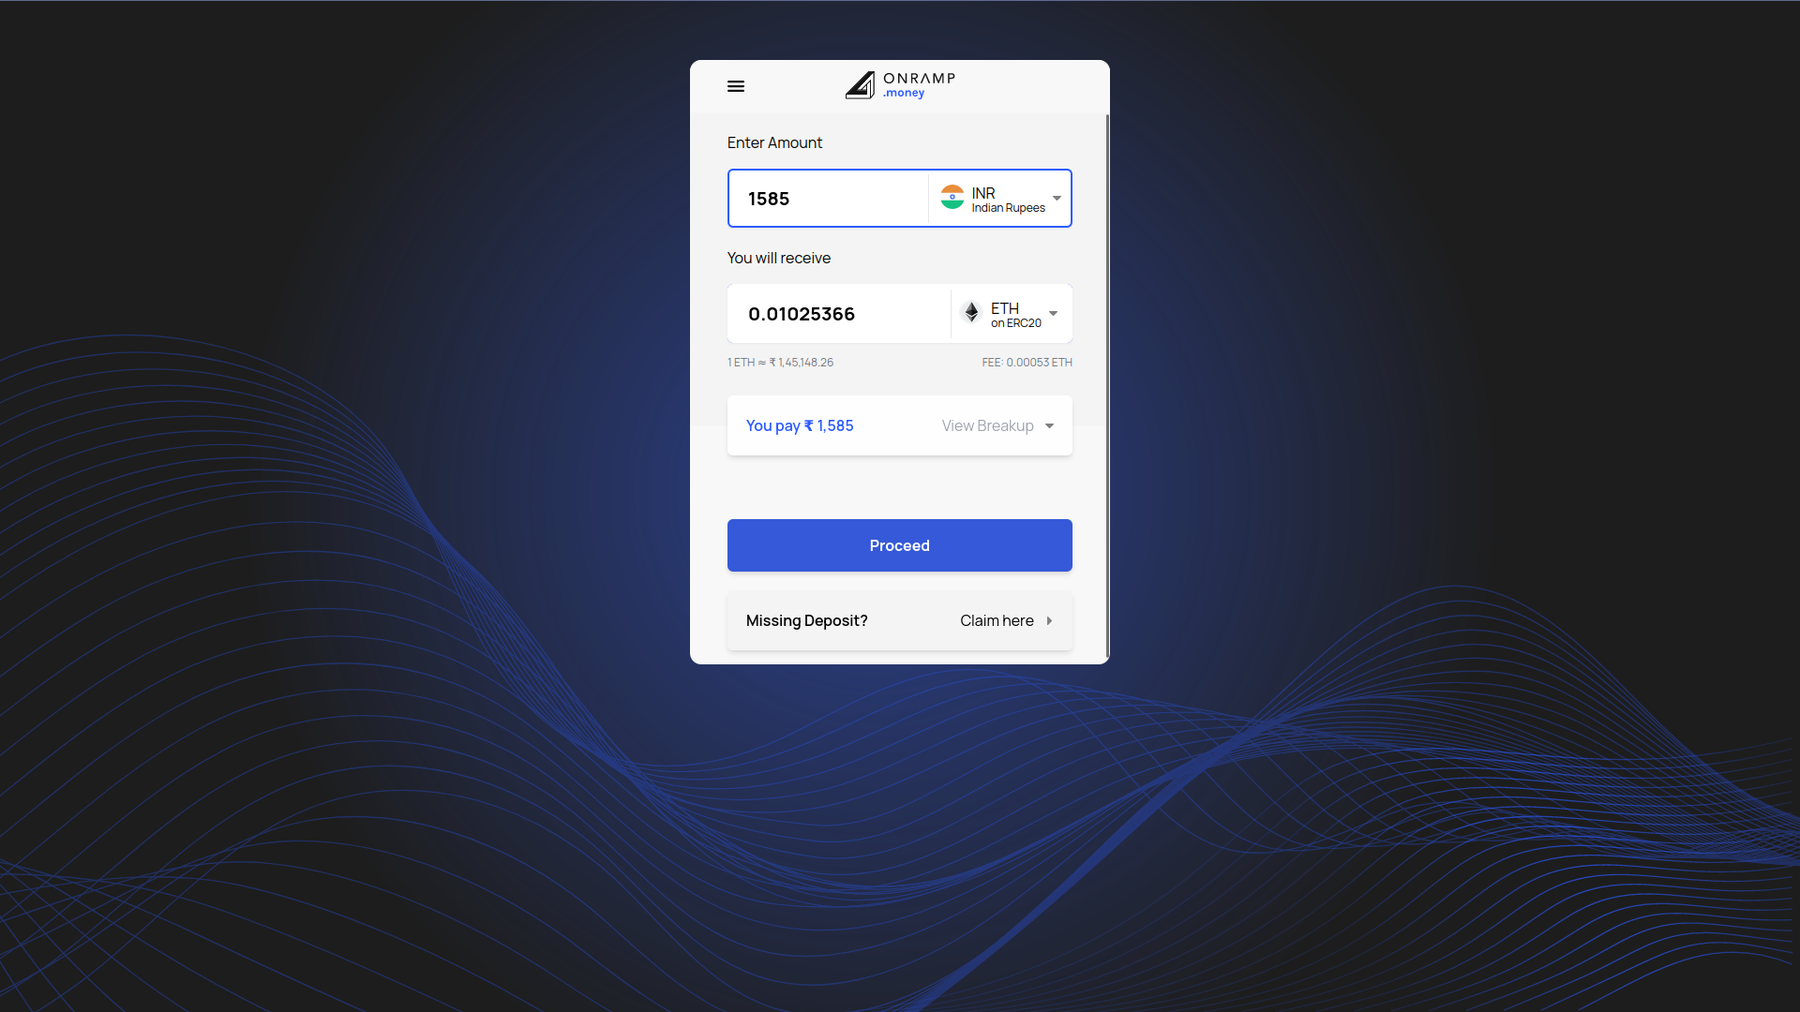

Slide 19
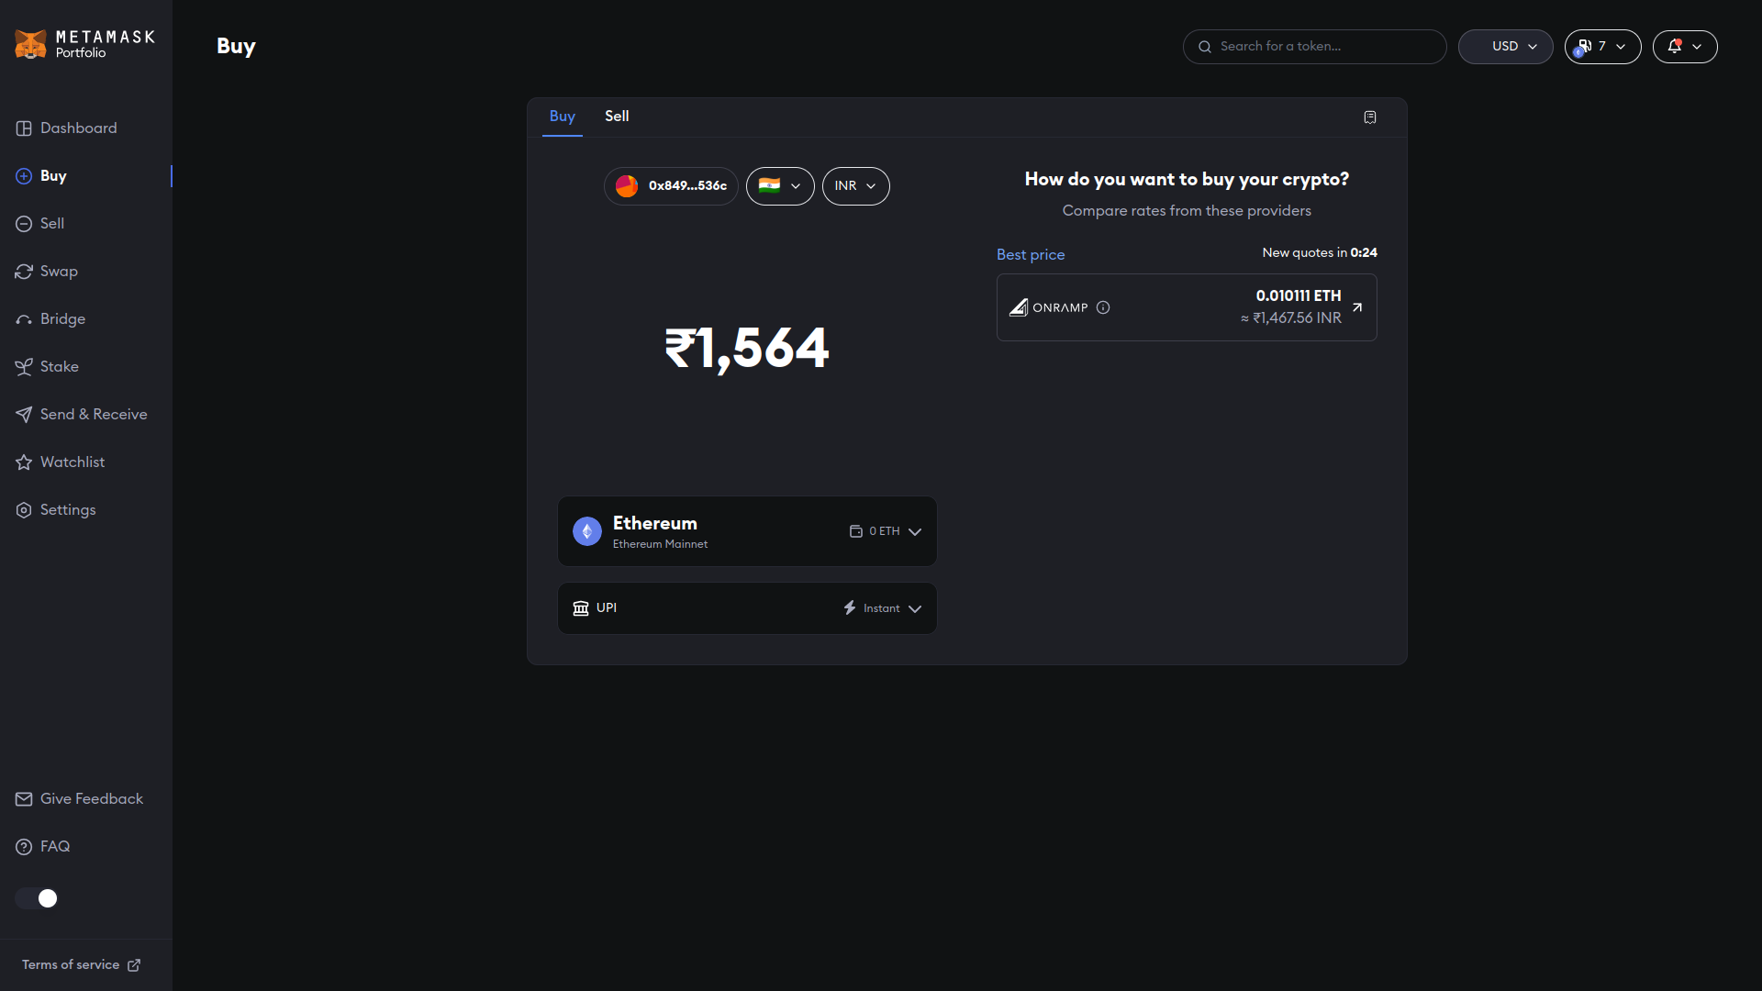

Slide 20
REFERENCES
[1] F. Fang, C. Ventre, M. Basios, L. Kanthan, D. Martinez-Rego, F. Wu, and L. L, "Cryptocurrency Trading: A Comprehensive Survey," Financial Innovation, vol. 8, no. 13, pp. 1-59, 2022. [Online]. Available: https://doi.org/10.1186/s40854-021-00321-6.
[2] D. P. Sakas, N. T. Giannakopoulos, N. Kanellos, and C. Tryfonopoulos, "Digital Marketing Enhancement of Cryptocurrency Websites through Customer Innovative Data Process," Processes, vol. 10, no. 5, p. 960, 2022. [Online]. Available: https://doi.org/10.3390/pr10050960.
[3] P. D. DeVries, "An Analysis of Cryptocurrency, Bitcoin, and the Future," International Journal of Business Management and Commerce, vol. 1, no. 2, pp.1-9, September 2016.
[4] F. E. De Guzman, B. D. Gerardo, and R. P. Medina, "Implementation of Enhanced Secure Hash Algorithm Towards a Secured Web Portal,"2019 IEEE 4th International Conference on Computer and Communication Systems (ICCCS), 2019, pp. 189-192, doi:10.1109/CCOMS.2019.8821763

Slide 21



Slide 22

BACKGROUND
Cryptocurrencies form a important aspect and part of our economy, and as it is a fairly new emerging domain, the information resources are widely scattered. This proves to be a major hurdle for potential and new investors as well who want to learn about this domain. Combining information from multiple resources - evaluating which ones to trust at the same time, and doing all this at regular intervals of time (considering the volatality of cryptos) increases the slope of the learning curve involved even more.

Slide 23
ABSTRACT
The cryptocurrency Analysis WebApp is a web-based application which provide the easy and live trends of the top current cryptocurrencies such as ETH, Bitcoin, Dogecoin etc at one place in a combined manner and their past records which will ultimately help us to make better investments and also provide us the insights to make a profitable future investment in the crypto currencies. This app will provide the latest data and records such as the current price of each cryptocurrency (in INR as well as USD), their rank, market cap and the rise or fall in the value within the past 24 hours, you can search the results for any desired cryptocurrency. It will help the people to invest in these cryptocurrencies and get the most benefit out of that, as many crypto lovers are investing and buying the crypto currencies for the sake of making profitable investments. The app will also have major application areas such as in the field of market and industry and in the investment sector as well.

Slide 24

FIELD OF INVENTION
The field of invention for a cryptocurrency tracker website that tracks records of all top trending cryptocurrencies is FinTech or Financial Technology.
The website falls under the subfield of cryptocurrency tracking and analysis, which involves using technology to monitor, analyze, and report on the performance of various digital assets, including cryptocurrencies such as Bitcoin, Ethereum, and others.
The website could also fall under the subfield of data analytics, as it would involve collecting, processing, and presenting large amounts of data to users in an easily digestible format.

Slide 25
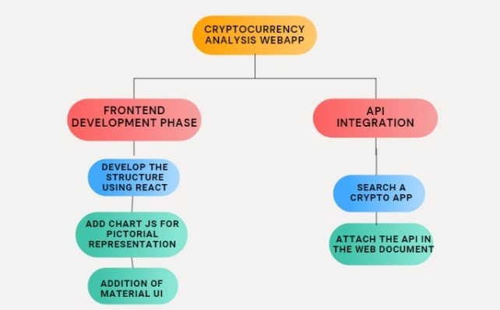
FLOWCHART

Slide 26

OUTCOMES
A cryptocurrency tracker app can have several outcomes, including:
Real-time monitoring: A cryptocurrency tracker app allows users to monitor the prices of various cryptocurrencies in real-time. Users can set alerts for specific price changes, allowing them to make informed decisions about buying, selling or holding their crypto assets.
Market analysis: The app can provide market analysis, including historical price charts, technical indicators, and trading volumes. Users can use this information to make informed decisions about the cryptocurrency market.
News and updates: A cryptocurrency tracker app can also provide news and updates related to the cryptocurrency market, including new coin listings, regulatory changes, and other important events.

Slide 27
ADVANTAGES
Allows to track the total amount and value of cryptocurrencies across various wallets.
This web app let you track historic transactions, their worth, and destinations or sources.
This web app also give the actual live price of any cryptocurrencies .

Slide 28


END USERS
End users of a cryptocurrency tracker app can vary, but generally include anyone interested in investing or trading cryptocurrencies. Here are some examples of potential end users:
Cryptocurrency investors: These are individuals who have invested in cryptocurrencies and want to monitor their portfolio's performance and stay up-to-date with the latest market trends.
Traders: These are individuals who trade cryptocurrencies frequently, looking for opportunities to profit from price fluctuations in the market. A cryptocurrency tracker app can help traders by providing real-time market data, analysis tools, and trading signals.
Casual enthusiasts: These are individuals who are interested in cryptocurrencies and want to stay informed about the latest news and trends in the market. They may not be actively investing or trading cryptocurrencies, but are still interested in learning about the market.

Slide 29


FUTURE SCOPE
The crypto based web-app has a wide scope in the upcoming world as the awareness regarding the cryptocurrency investments is increasing day by day therefore people are more lean towards these cryptos and want to make better investments in these, this webapp can find applications in the stock markets and crypto transactions as well as can be used by various industries and tech giants to make profit and boost the growth of their company and the economy by making a fruitful and profitable investments.

Slide 30

CONCLUSION
The cryptocurrency is the trend of today’s generation and people are investing in these cryptocurrencies to gain maximum benefit from these investments hence a centralized data is required so that people can analyze the various cryptocurrencies and can make the best possible investment based on the market price,trends,market cap of these cryptos hence a crypto tracker web app came to rescue as they provide a centralized system where people can watch and compare cryptos before making any investments hence to secure and maximize the profit.

